Slide 1
Presentation
Team members & Presenters
Leah Hou & Bryce Harlum
Notes:
Entry Page & intro of team – 5 sec

Slide 2
Notes:
Problem Defined – 10s
By leah

Slide 3
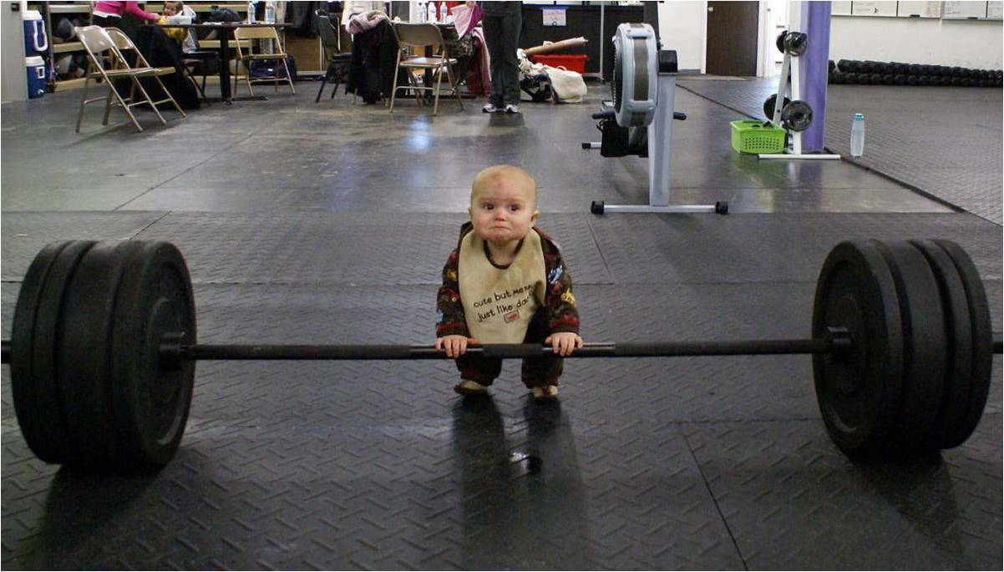
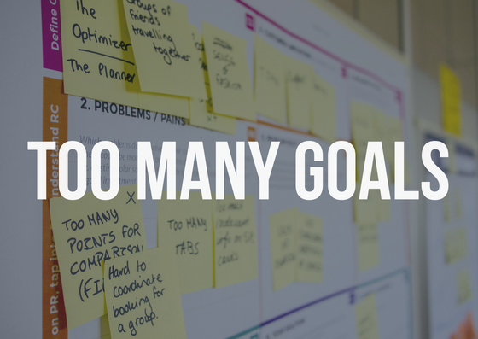

Unrealistic goal
Poor time management
Too many goals
Lack of support
Lack of motivation
Notes:
Possible Reasons for failures – 10 sec
By leah

Slide 4

Your solution
A terminal application that will help you hit your goals and get donuts!
Notes:
Solution of the problem – 3 sec
By leah

Slide 5
What Goalnut can do for you!
Set multi goals & multi actions to achieve them
Log in your actions
Analyze your activities
Give feedback on:
Diagnose on reasons why goals haven’t met
Advice on unrealistic goals if goals constantly unmet against actions
Provide advice on goals prioritization and time management
Give rewards and encouragement in form of cumulating virtual donuts
Community support by connecting with other goalnut users
Notes:
Master Features of Goalnut – 20 sec
By Bryce

Slide 6
MVP
Feature One: Goal Setting
The application allows users to set ONE goal. For example, a goal could be to "exercise more this year".
Feature Two: Action Setting
The application allows users to set :
One action they would like to do to achieve their goal, such as "jogging".
Set the expected frequency of the action, such as "3 times a week"
Set the expected duration of the action, such as "30 mins jogging"
Feature Three: Action Logging per week
Log in all activities once a week, recoding times of actions executed, and duration of each action
Feature Four: Track Progress and be rewarded per week
Calculate the percentage the users who have hit their goals.
For example, "80% of time you have run 30 mins this week"
Give average of your actions.
For example, "on average, you have run 20 mins this week"
Give Ascci donut artwork as rewards when goals achieved
Give encouraging words when goals haven’t been achieved
Notes:
Master Features of Goalnut – 20 sec
By Bryce

Slide 7
A tour to the terminal app
Notes:
A tour to the terminal app + MVP – 1 mins
By Bryce & Leah

Slide 8
Challenge !!!
Notes:
Challenges – 30 secs
By ?

Slide 9
Fun Part!
Notes:
Fun part

Slide 10
Social impact & Unethical use
Positive social impact
The application is created to help people feel positive about their accomplishment when achieving the goal
Implement members with useful tools to achieve their goals
Building a community to help each other achieving what they would like to achieve
Possible misuse of Goalnut
The sense of community should be carefully designed for encouragement and support, and should not be used to increase unnecessary competition.
Goalnut used should be correctly encouraged, rather than being criticized if they haven't achieve their goals
Encourage wrong goal. E.g. encourage eating disorder
Notes:
Social impact and unethical use – 20 sec
By Leah

Slide 11

Notes:
Q&A – 1 mins

